Slide 1

Meeting 23-3-2022
Rosa Maessen

Slide 2
Project Proposal
Research Question
Research question:
Can skill mutation result in better performance when doing robot-to-robot learning?
Sub-questions:
How does the skill of a robot mutate during robot-to-robot learning?
Does the skill of a robot mutate during robot-to-robot learning?
Is skill mutation repeatable when using the same conditions?
What enables the mutation of the robots’ skills?
09-10-2020

Slide 3
Hypothesis 1
How does the skill of a robot mutate during robot-to-robot learning?
During the first skill learning steps, the skill mutation will be obviously visible. This is expected as the demonstrated behavior of the human is assumed to be suboptimal, and multiple steps are needed until the collaborative task mutates to an optimal solution.
If there are no external factors influencing the behavior of the robot, the robot's mutation will eventually converge, however as the experiments are done in the real world, which means lots of variability, this will most probably not happen.

Slide 4
Hypothesis 2
Is skill mutation repeatable when using the same conditions?
If set in the exact same conditions, the skill mutation is repeatable. However, this will most probably not follow out of the experiments as it is nearly impossible to set the exact same conditions.

Slide 5
Hypothesis 3
What enables the mutation of the robots’ skills?
Every aspect, which will be different from the previous trial, will influence the mutation of the robot's skill, as different conditions will result in different behavior.

Slide 6
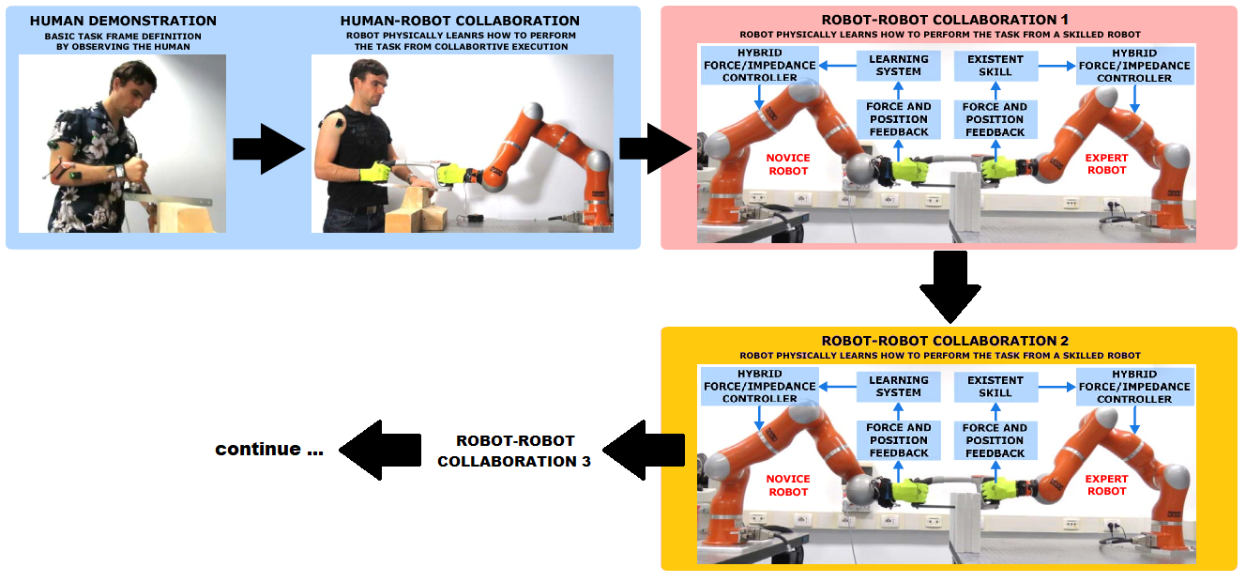
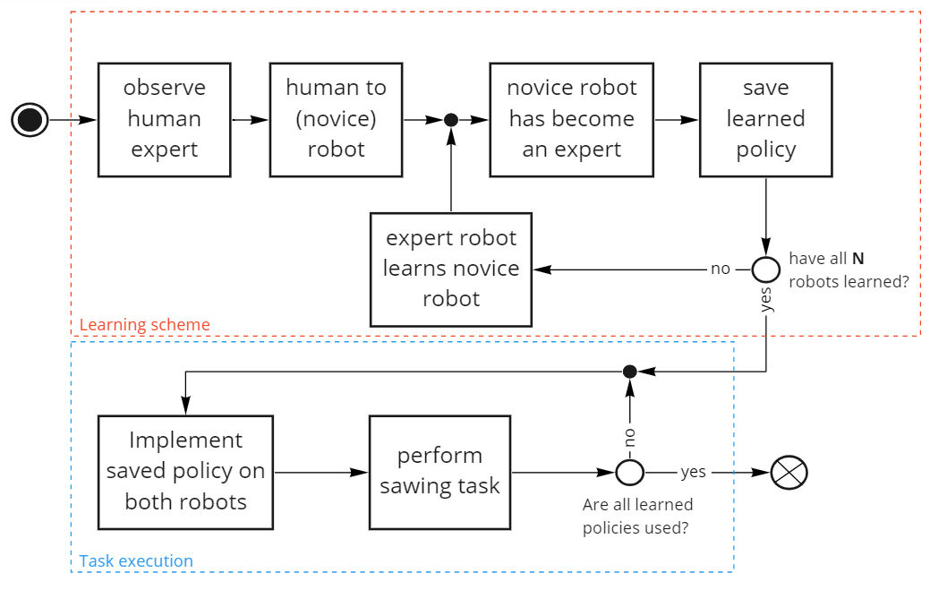
Experiment 1
09-10-2020

Slide 7
Experiment 2
Repeat experiment 1 multiple times, with the exact same conditions:
Human Demonstration
Starting position
Same parameters
09-10-2020

Slide 8
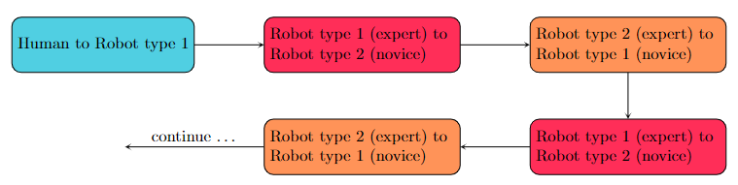
Experiment 3
Multiple conditions
Types of robot
Material
Frequency of sawing
Different demonstrations (e.g. multiple persons)
Different learning times
Learning types
09-10-2020

Slide 9
Python
Implemented
Tree staged learning scheme
Step 1: Learn position
Step 2: Learn Stiffness
Step 3: Autonomously perform task
Phase determined with:
Adaptive Phase Oscillator based on Adaptive Fourier Series (learn in step 1, repeat rest of time)
Learning from expert robot (multiple times)

Slide 10
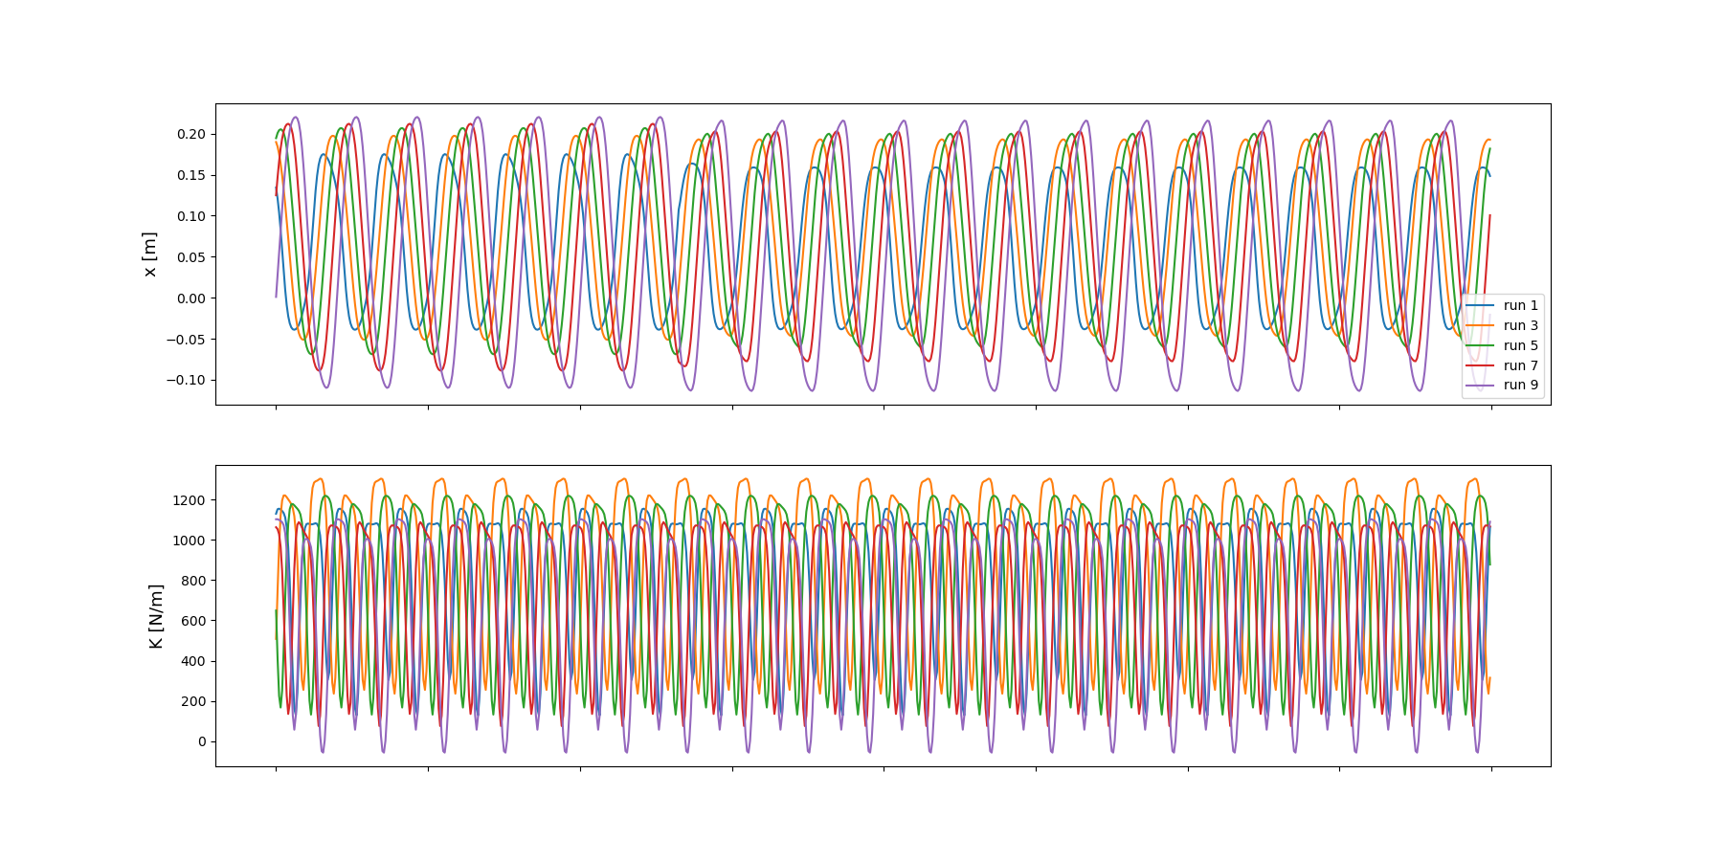
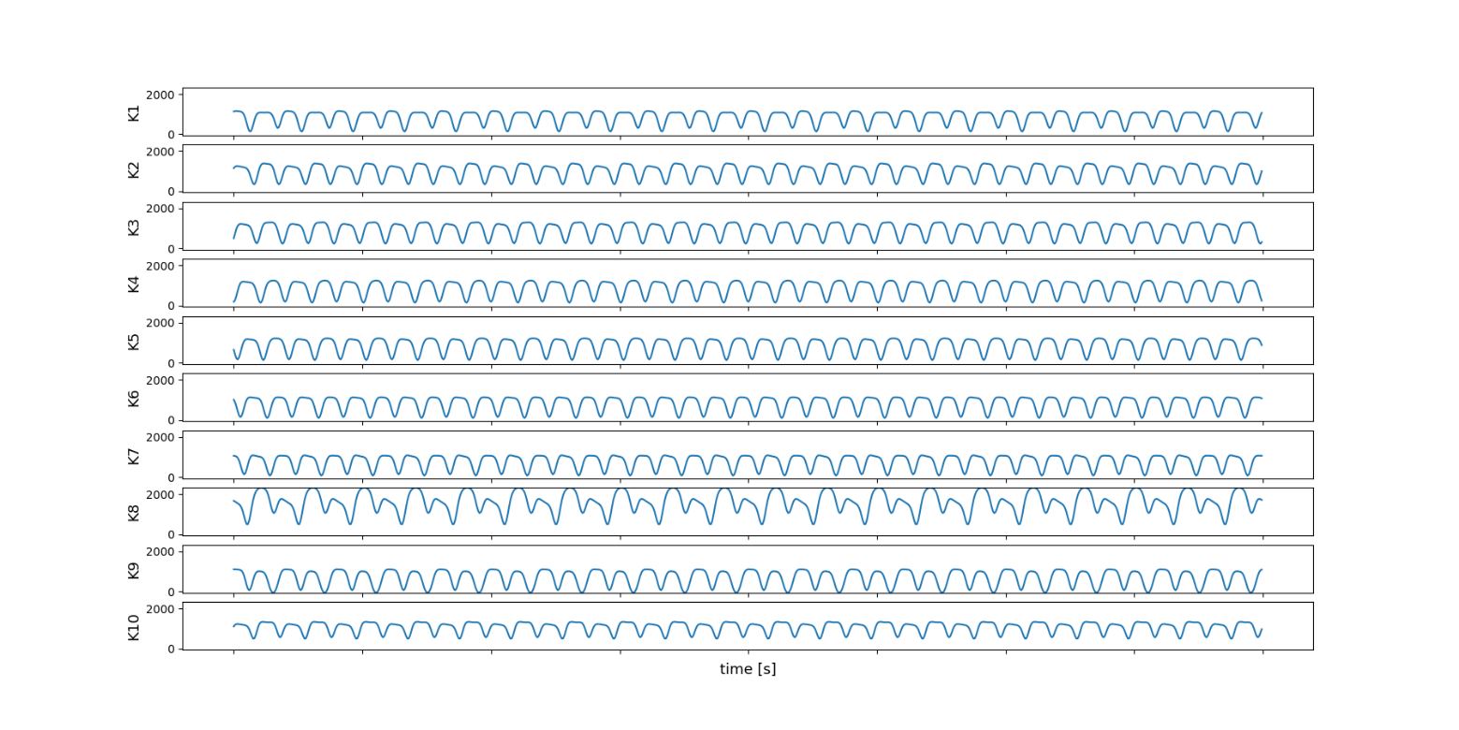
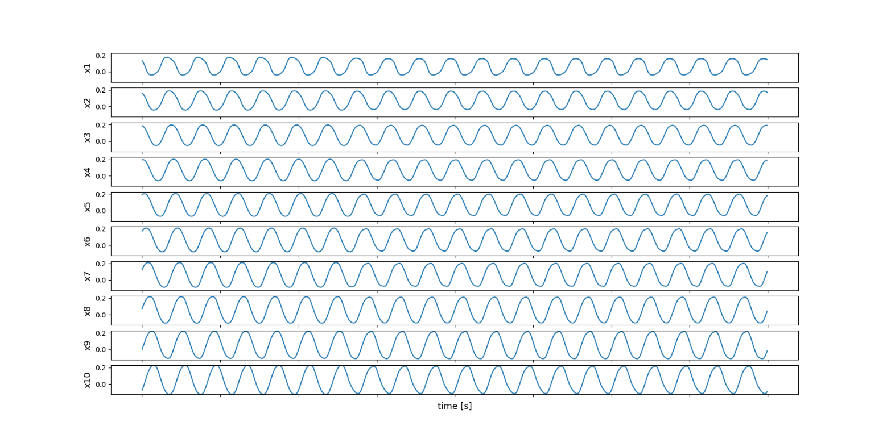
Using Frequency Works!
But: Phase Shift

Slide 12
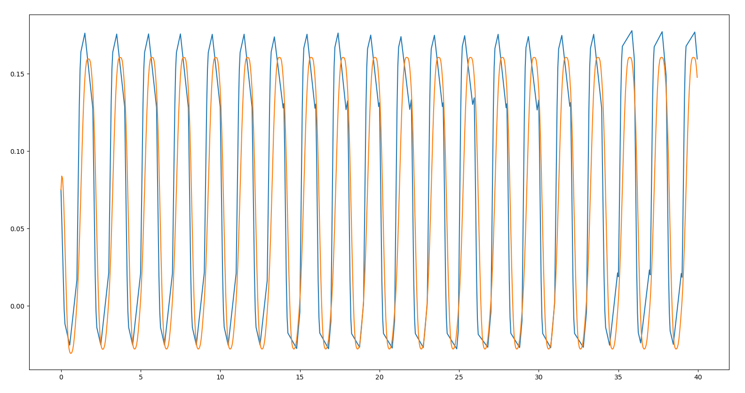
Phase Shift When Repeating the Signal

Slide 13
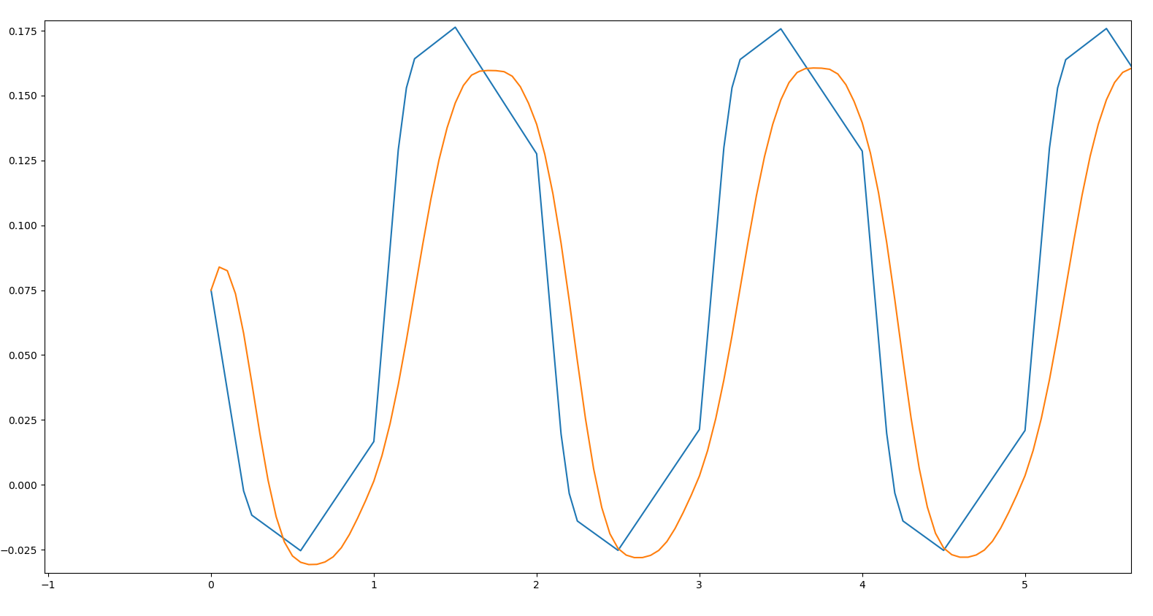
Phase Shift When Repeating the Signal

Slide 14
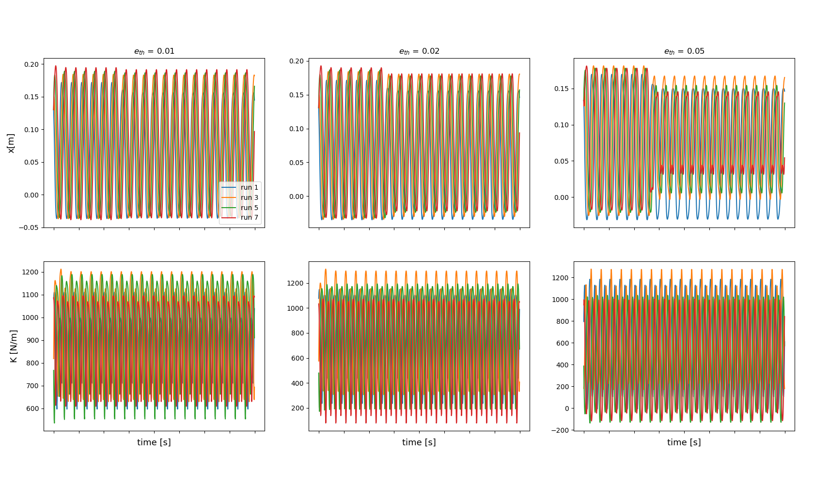
Effect of changing eth

Slide 15
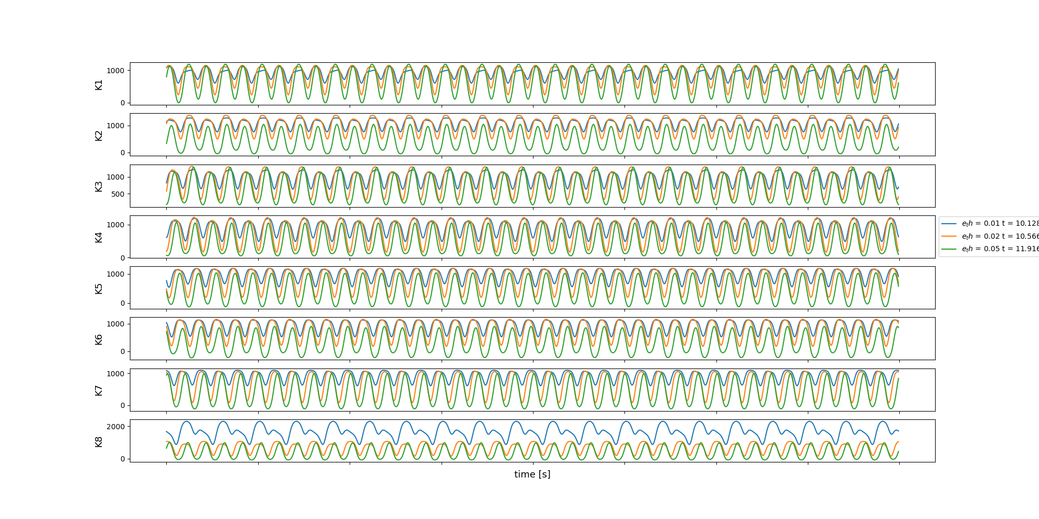
Effect of changing eth

Slide 16
Effect of changing eth

Slide 17
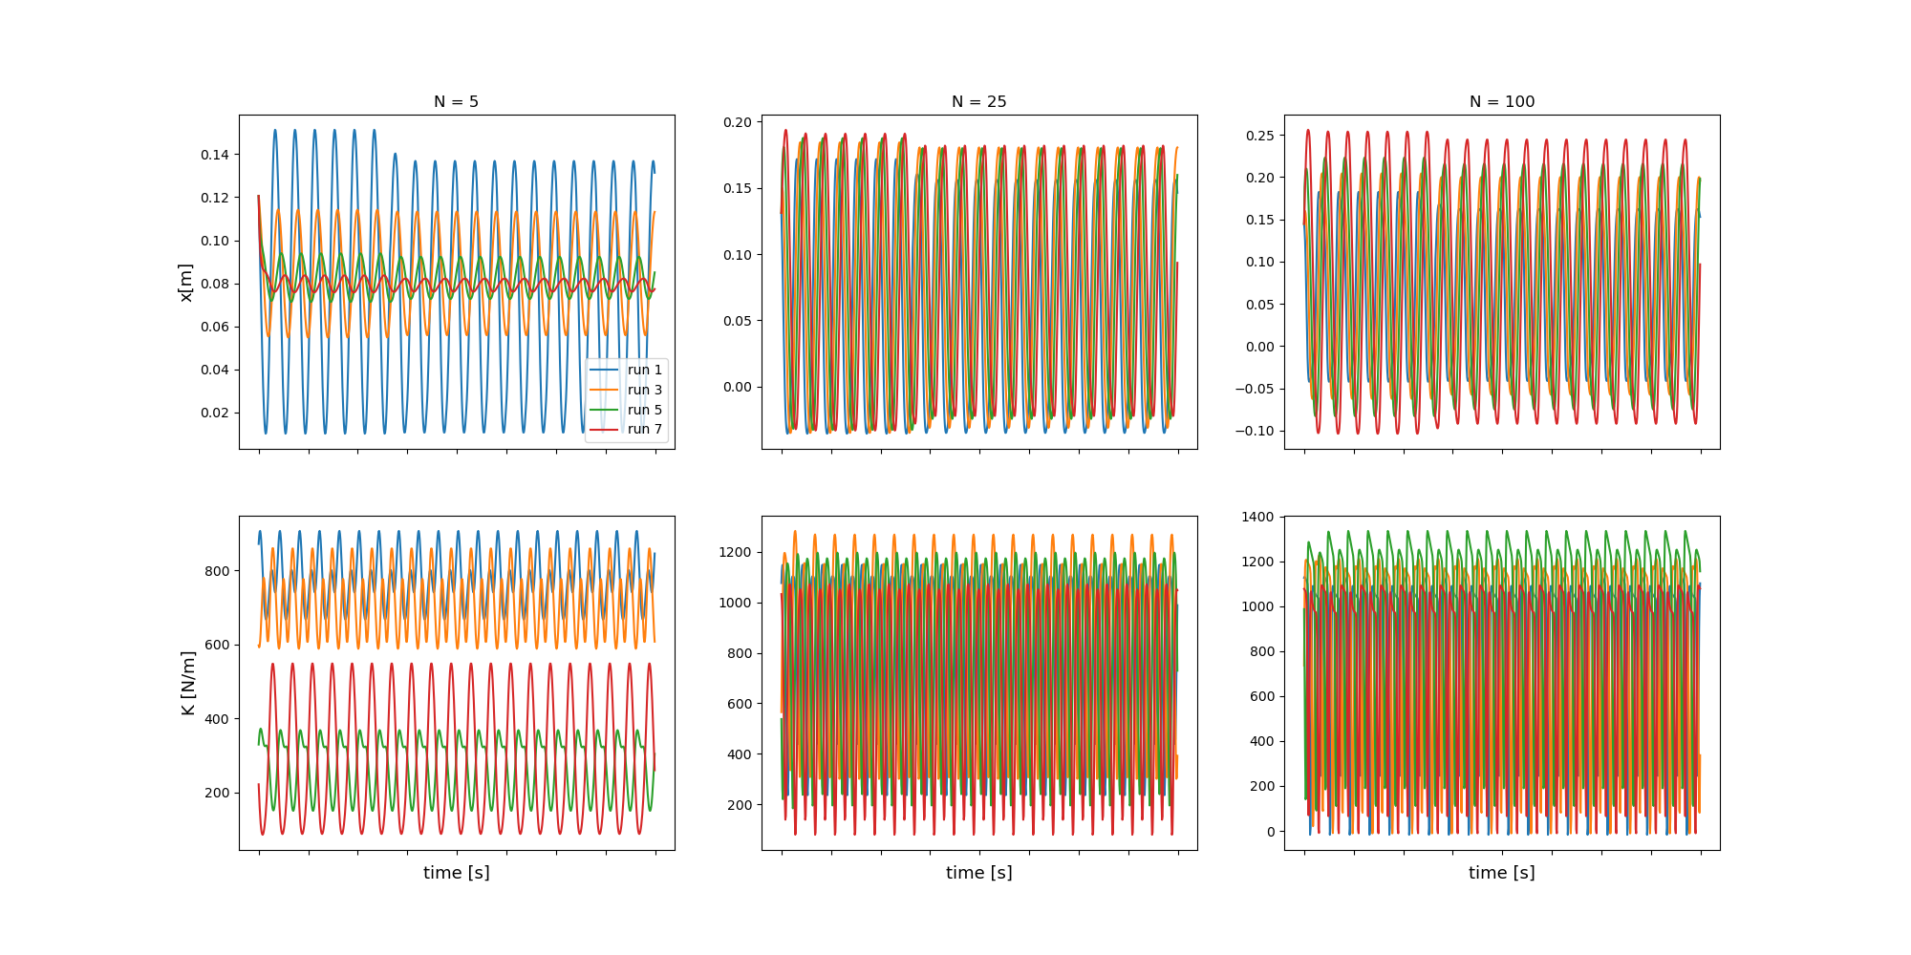
Effect of Changing N (eth = 0.02)

Slide 18
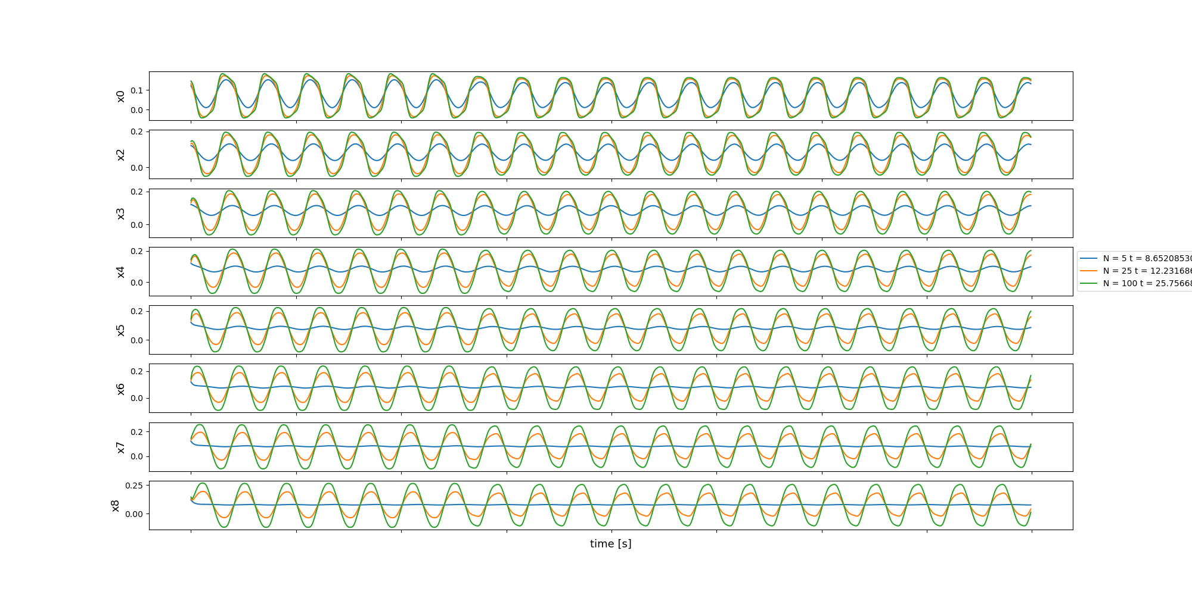
Effect of Changing N (eth = 0.02)

Slide 19
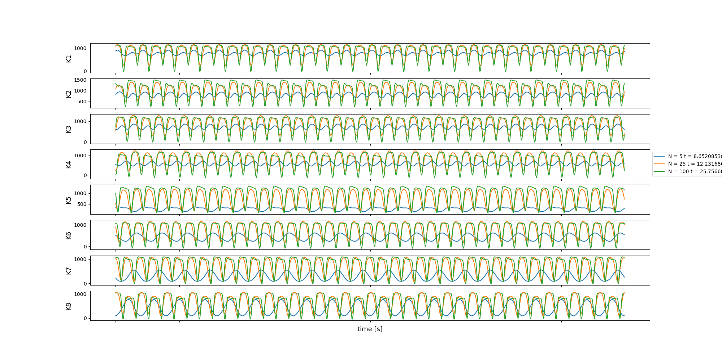
Effect of Changing N (eth = 0.02)

Slide 20
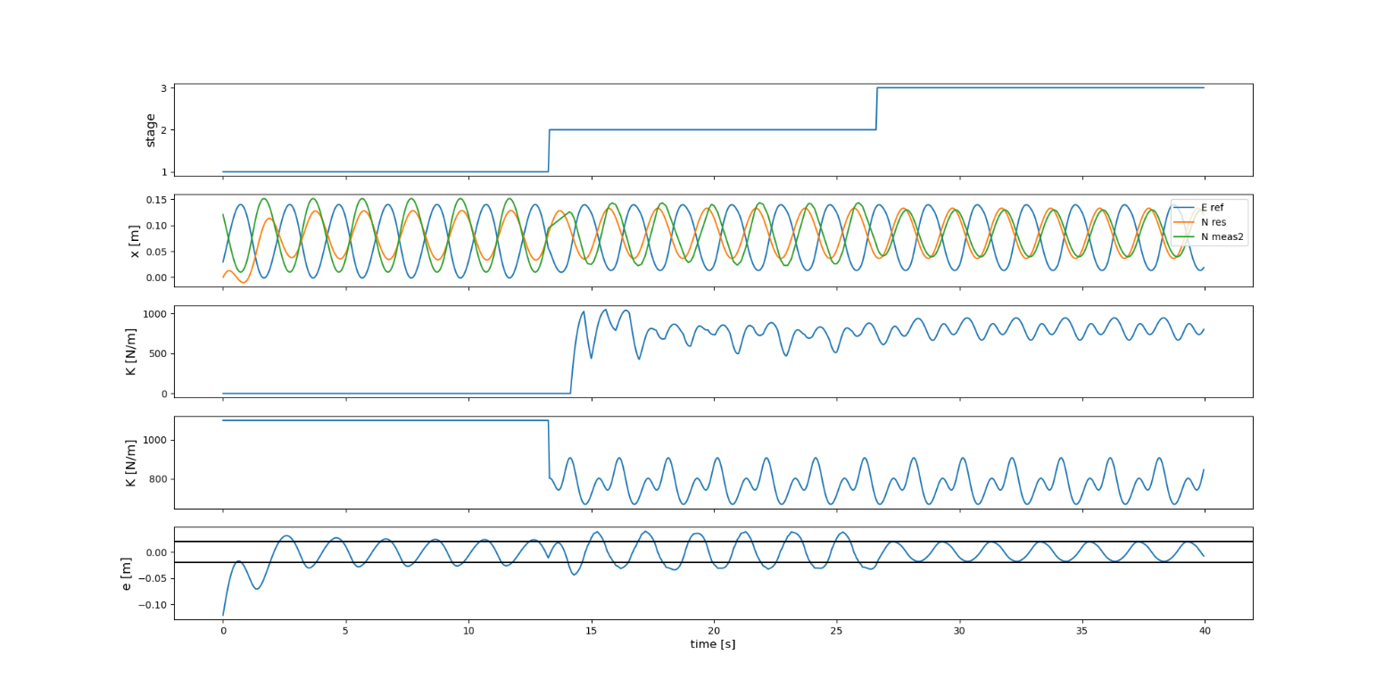
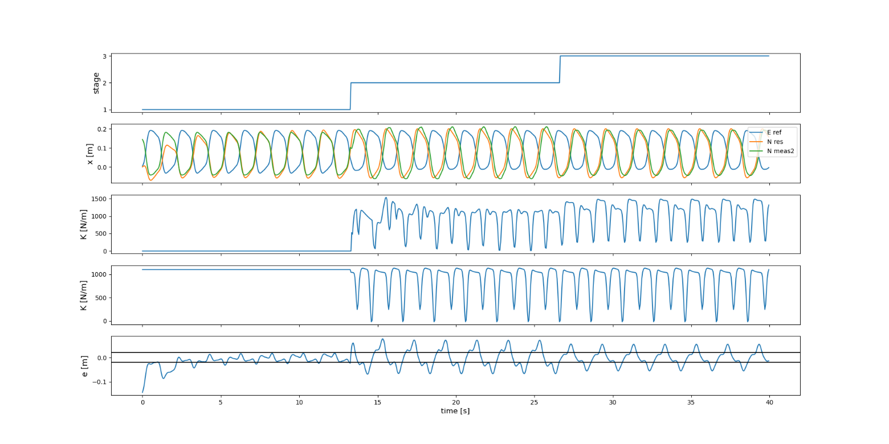
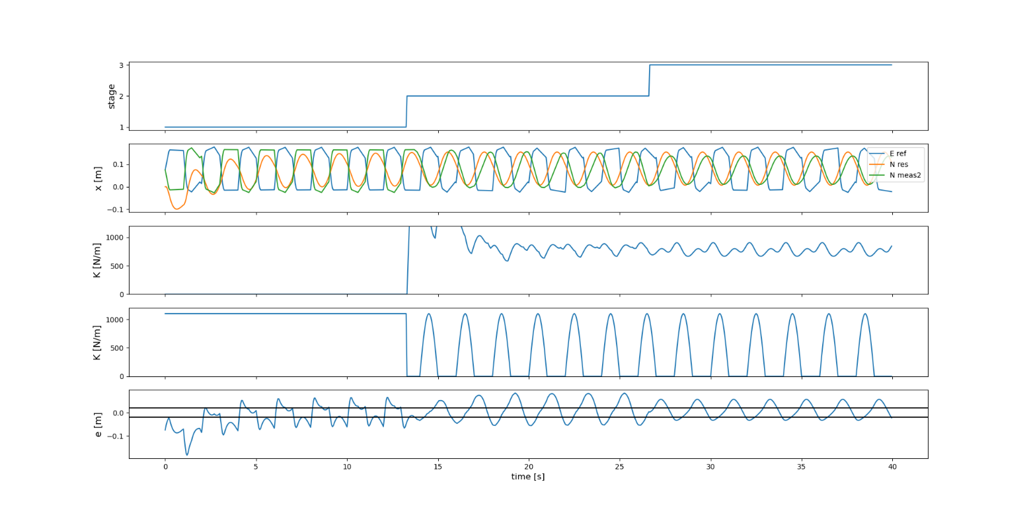
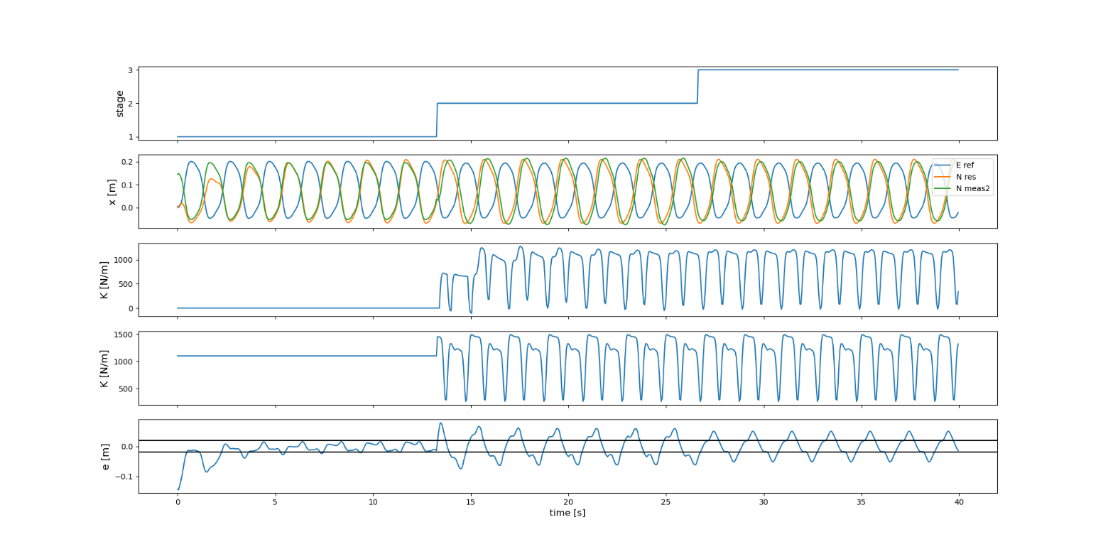

Slide 22
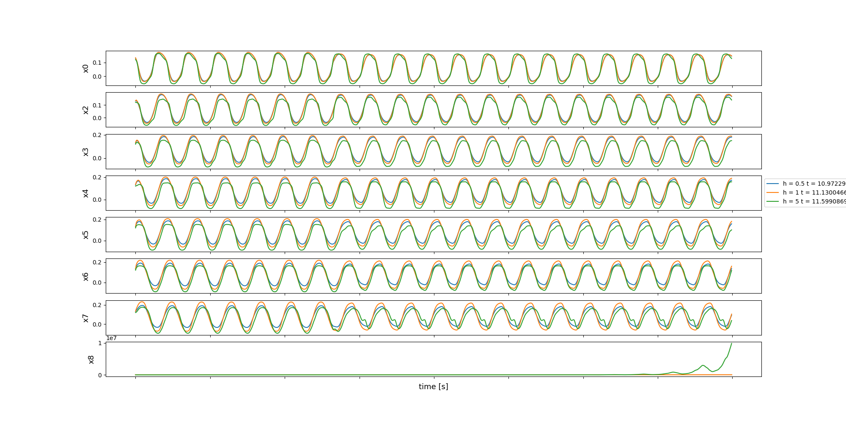
Effect of changing h

Slide 23
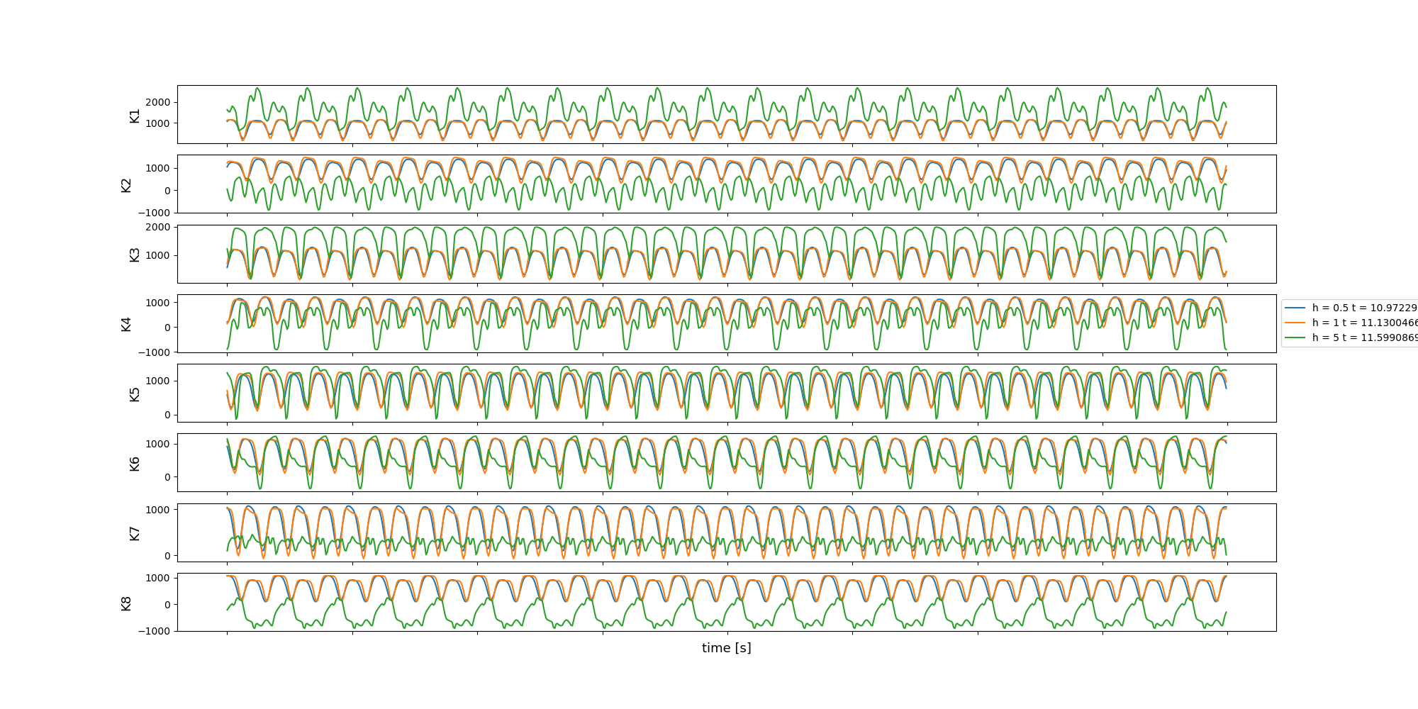
Effect of changing h

Slide 24
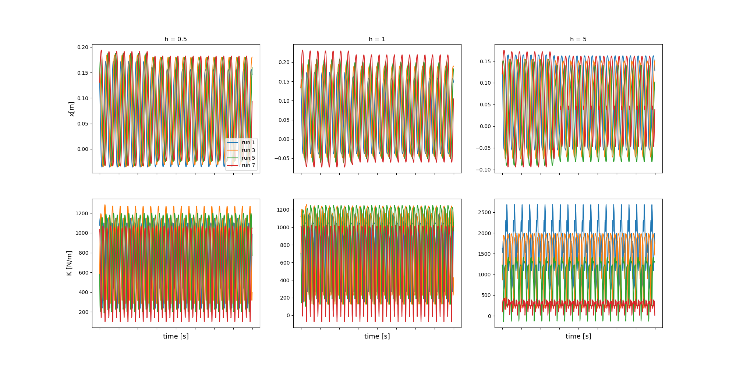
Effect of changing h

Slide 25
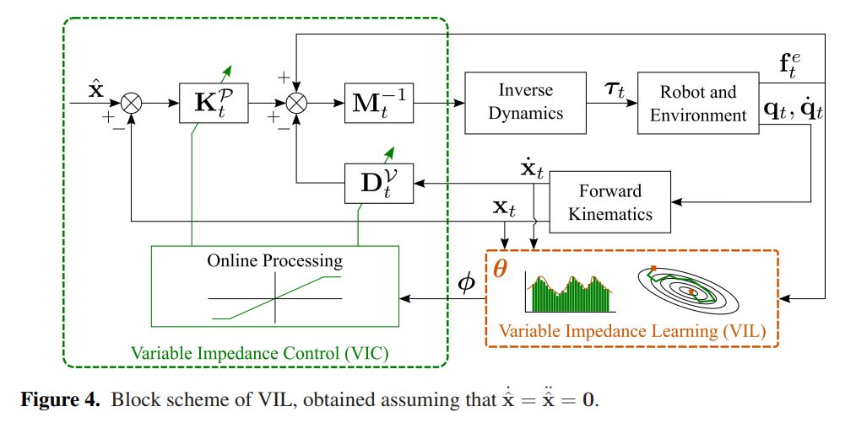
Variable impedance control
Abu-Dakka, F. J., & Saveriano, M. (2020). Variable impedance control and learning—a review. Frontiers in Robotics and AI, 177.

